Slide 1
readers & writers

Slide 2
What do you know
about readers and writers?
Are “readers” and “writers”
different from “reading” and “writing”?

Slide 3
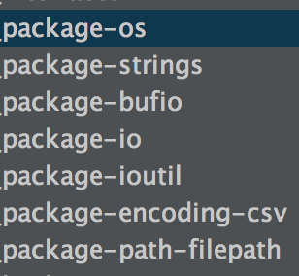
What might you find in these packages related to reading and writing?

Slide 4
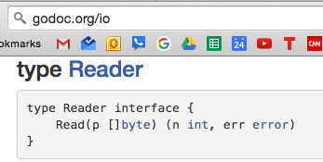
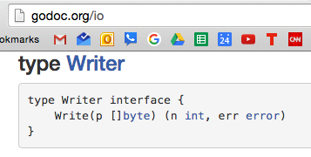

Slide 5
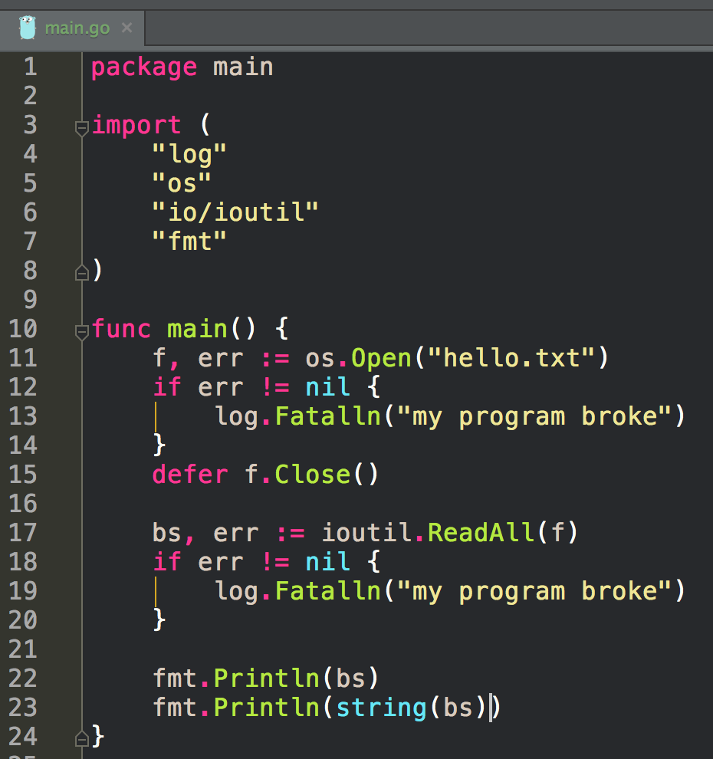
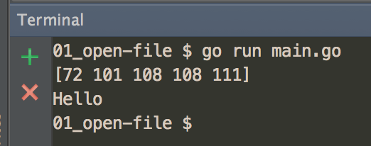
Reading A File

Slide 6
Reading A File
f
implements the
reader interface
ReadAll
takes a reader interface

Slide 7
Reader Interface
io.Reader

Slide 8

Remember what we learned about interfaces with our “vehicle interface” analogy
You could say
interfaces allow us to group things
by functionality; what they do; their methods
say I need to go from here to LA
I’ll need a vehicle to get there:
car, truck, bike, plane
all of those different modes of transportation implement the “vehicle interface”
they all satisfy the criteria for what it means to be a vehicle
a police officer might have a rule, “a vehicle can’t go through a red light”
a police officer could then pull you over if you went through a red light on a bike, motorcycle, car …
all of those different modes of transportation implement the “vehicle interface”
they all satisfy the criteria for what it means to be a vehicle
if we have a func that takes a reader interface
then anything that satisfies the criteria for what it means to be a reader
can be passed to that func
An interface is like
having more than one type:
“I’m a plane, and I’m a vehicle”
“I’m a truck, and I’m a vehicle”
“I’m a boat, and I’m a vehicle”
An interface is like
having more than one type:
“I’m a file, and I’m a reader interface”
“I’m a string, and I’m a reader interface”
“I’m a file, and I’m a writer interface”
ioutil.ReadAll takes a reader interface as an argument,
so it can take a file or a string:
func ReadAll(r io.Reader) ([]byte, error) { }

Slide 9
Reading A File
f
implements the
reader interface
ReadAll
takes a reader interface
an interface is a type
f is type *File and type reader interface
ReadAll takes type reader interface as an argument

Slide 10
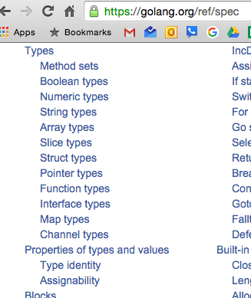
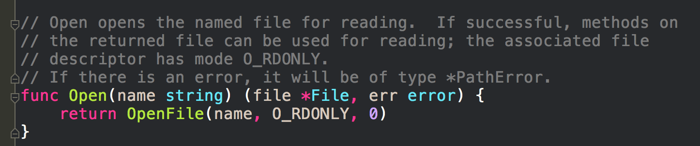
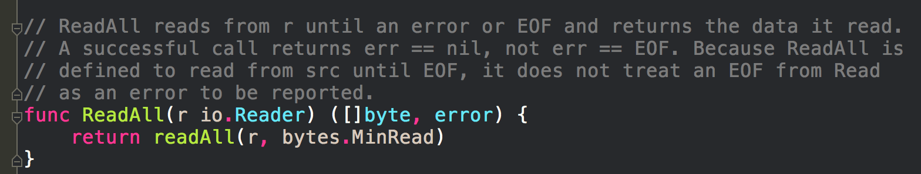
Reading A File
f
implements the
reader interface
ReadAll
takes a reader interface
an interface is a type
f is type *File and type reader interface
ReadAll takes type reader interface as an argument
f has two types:
*File
reader interface
How does *File implement the reader interface?

Slide 11
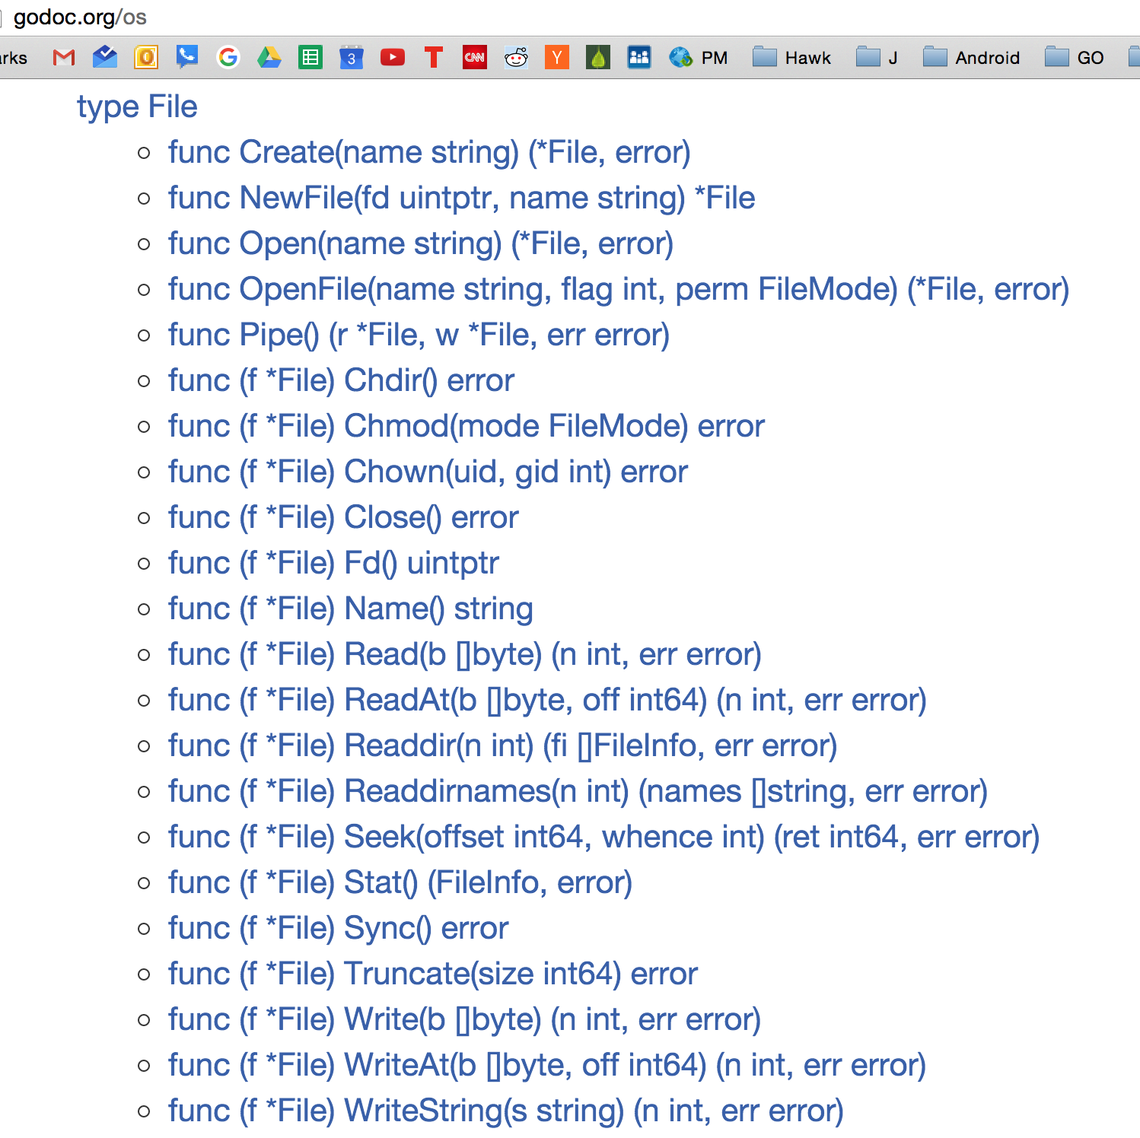
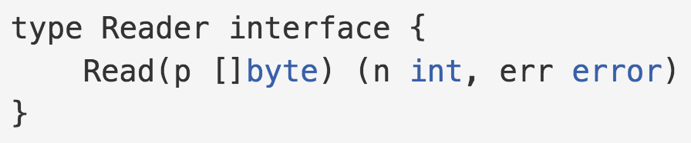
methods of *File
*File
implements the
reader interface

Slide 12
Reader Interface
io.Reader

Slide 13
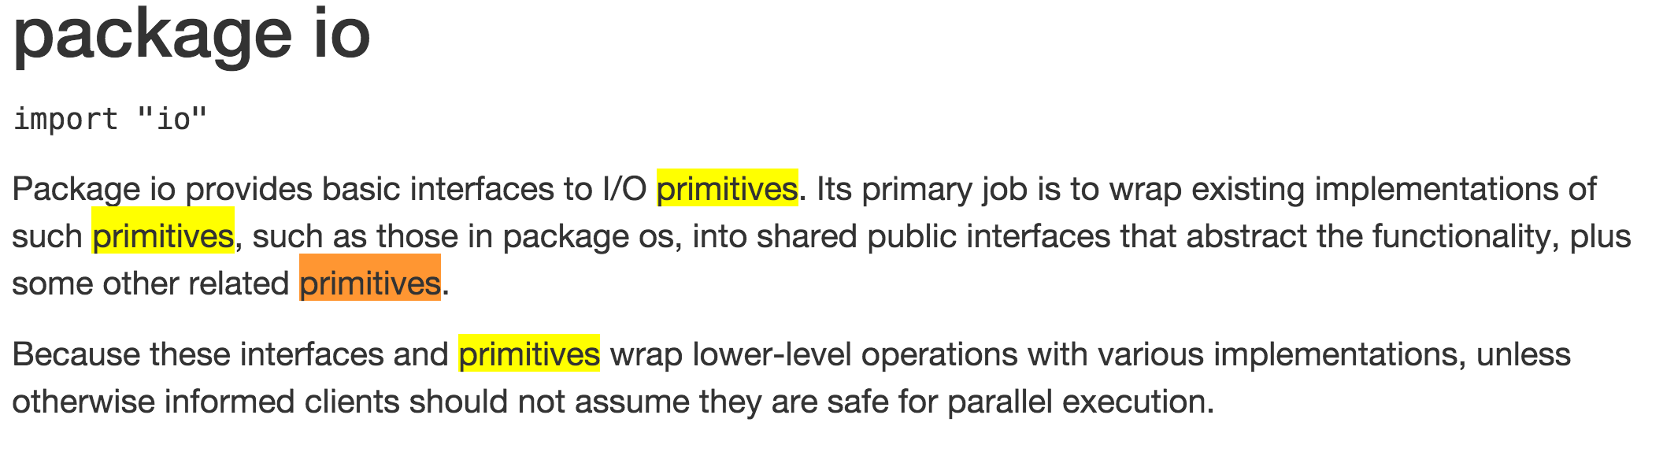

Slide 14
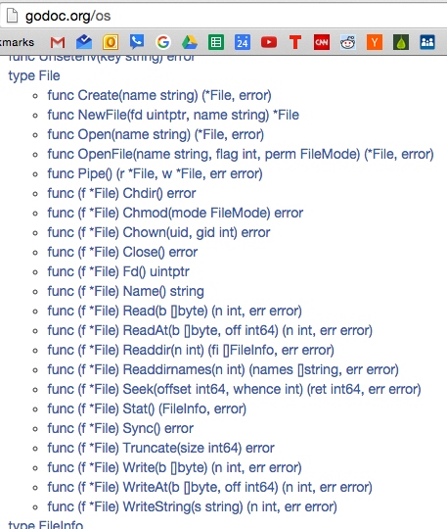

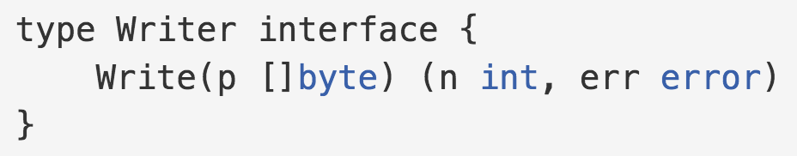

Slide 15
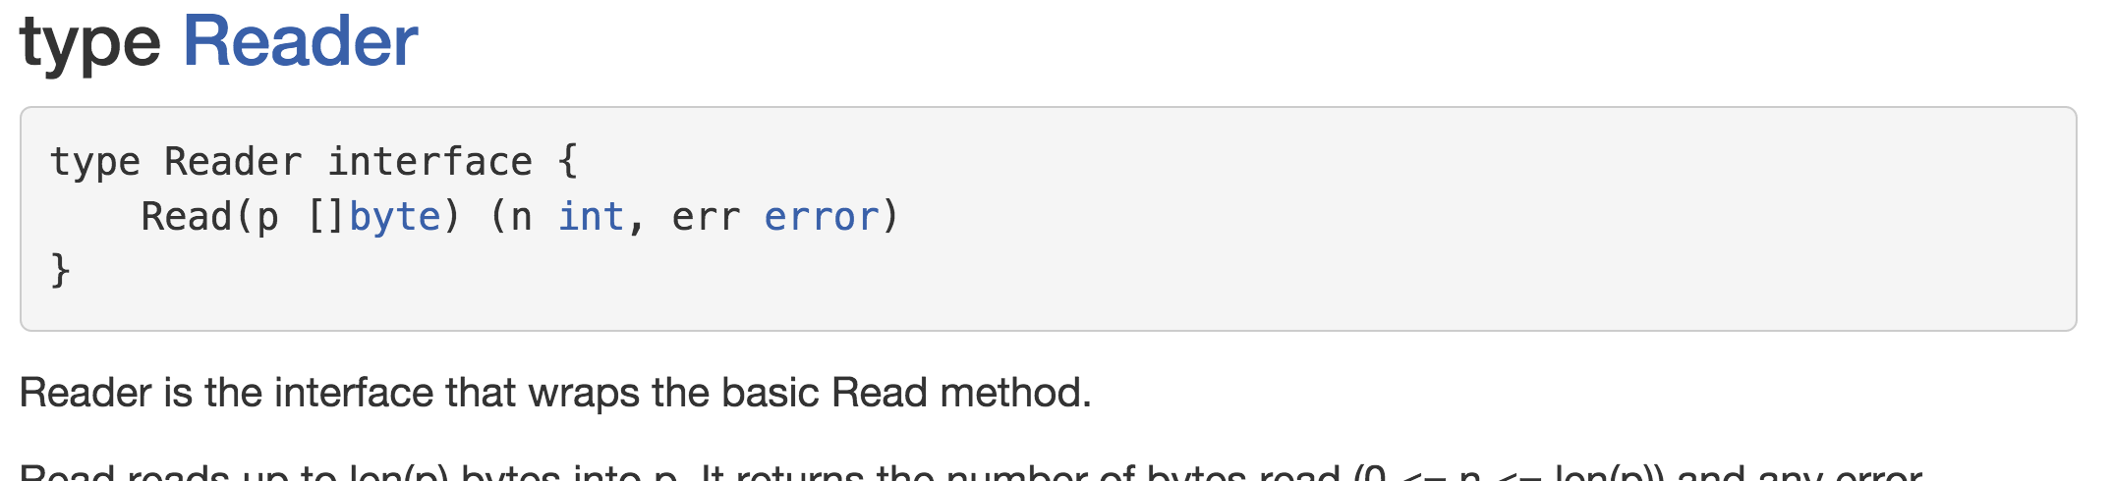
Any type with this method, implements reader interface

Slide 16
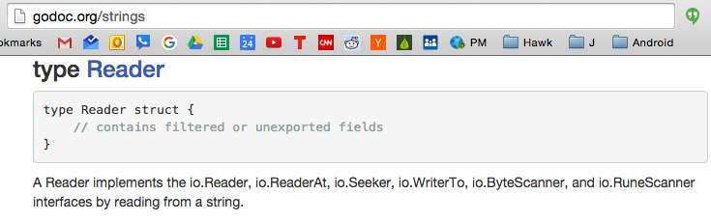
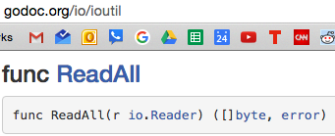
Different packages can have funcs with the same name

Slide 17
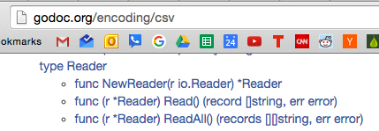
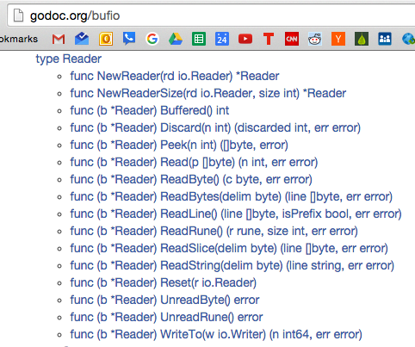
Different packages can have funcs with the same name

Slide 18
Reader Interface
What does it take for a type to implement the reader interface?
io.Reader

Slide 19
Reader Interface
What does it take for a type to implement the reader interface?
io.Reader

Slide 20
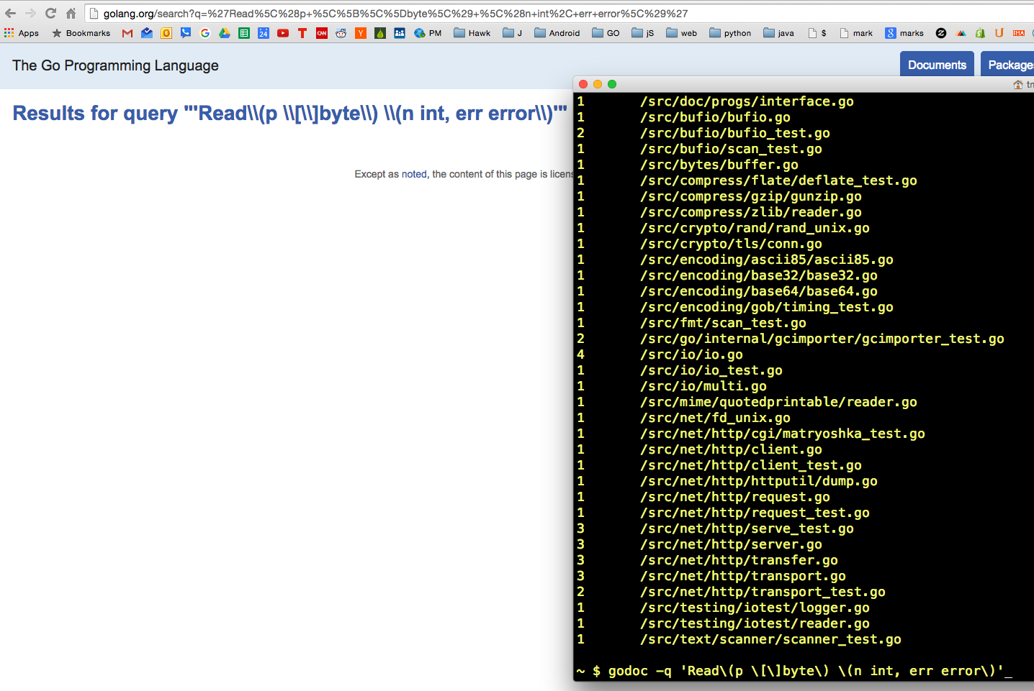
Who implements the io.Reader interface?

Slide 21
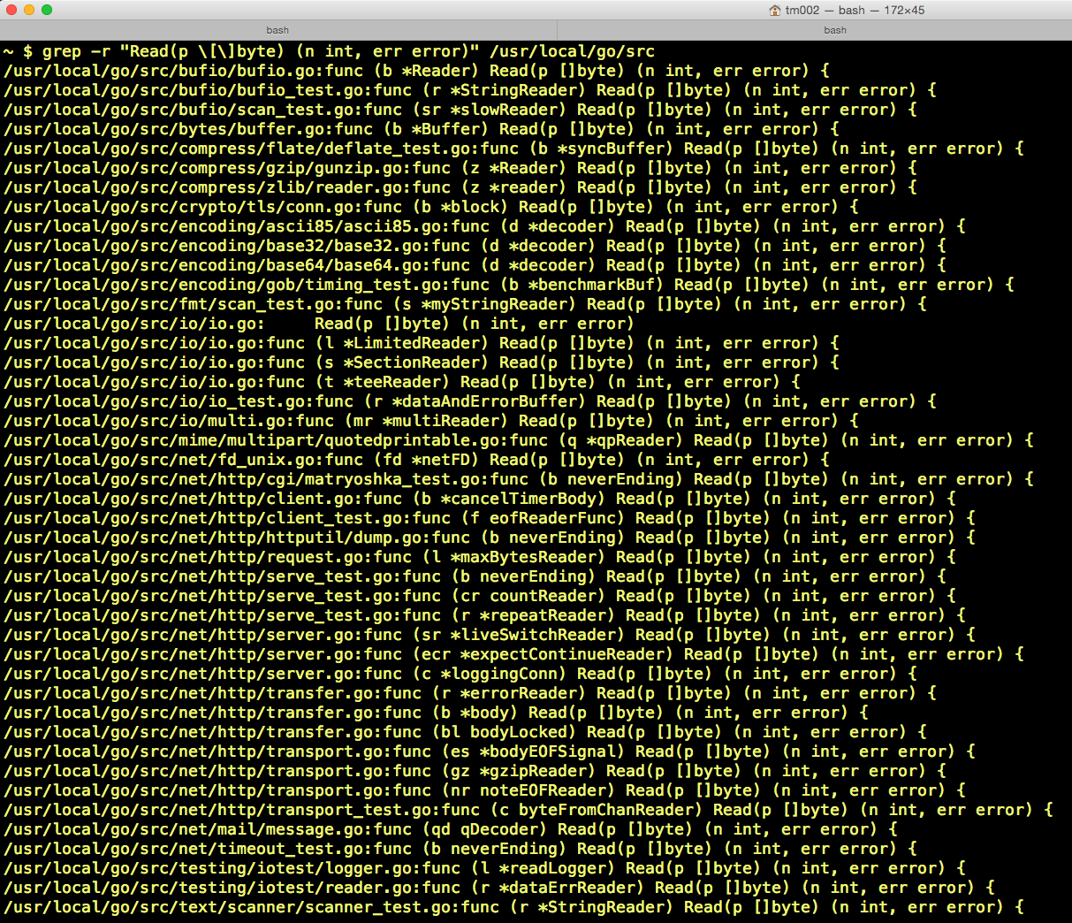
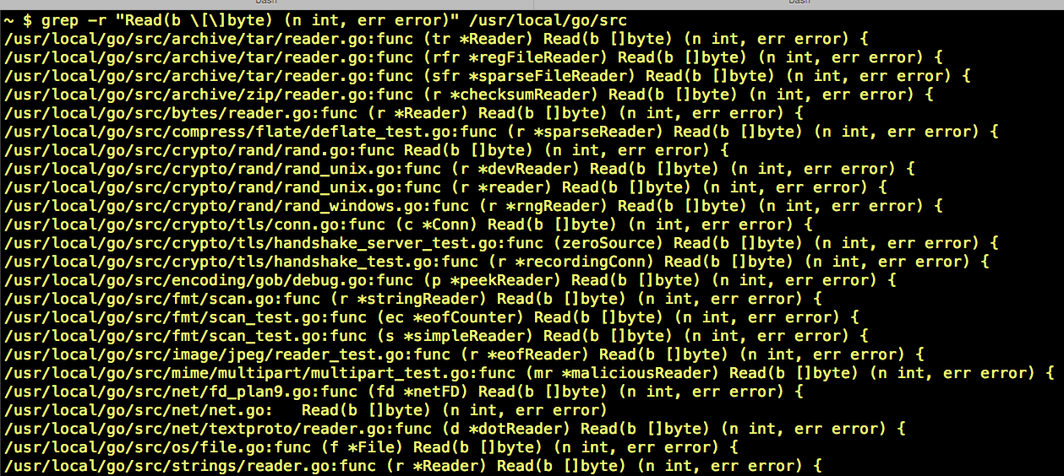
Who implements the io.Reader interface?

Slide 22
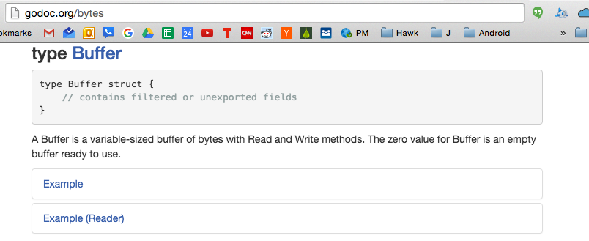
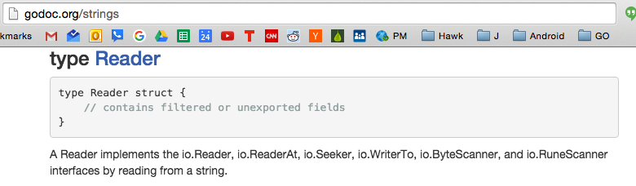
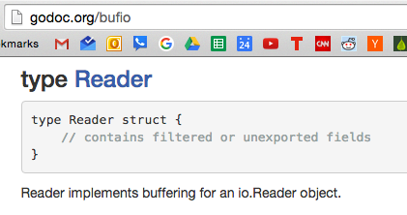
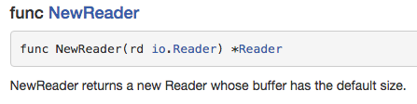
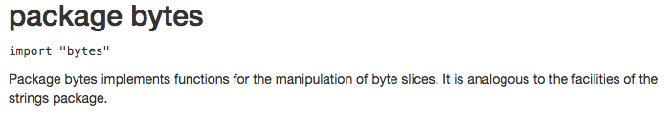
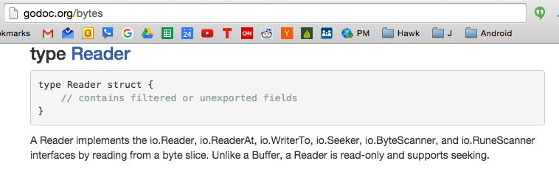
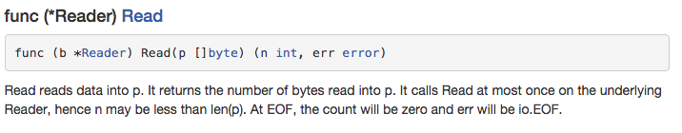
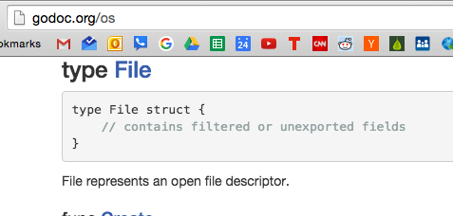
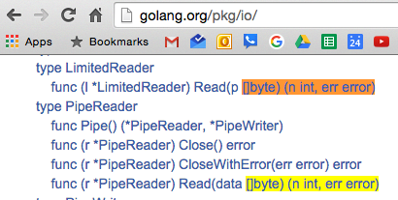
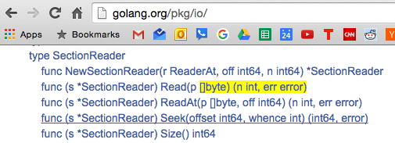
These types implement the io.Reader interface

Slide 23
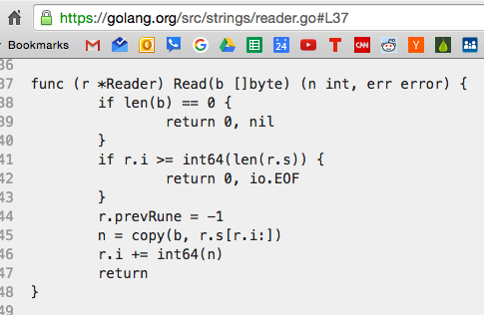
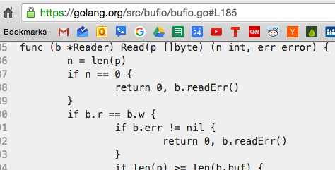
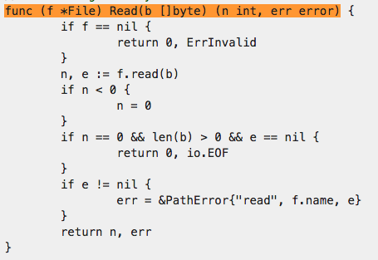
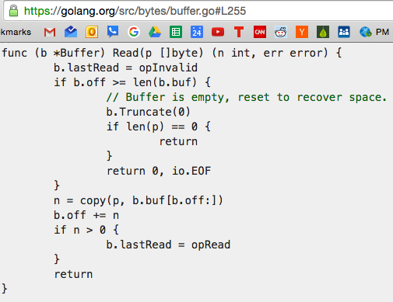
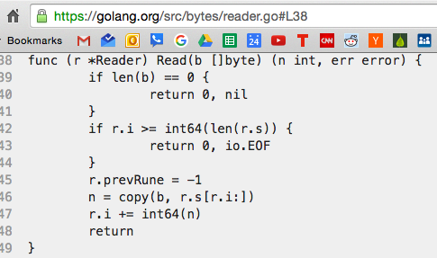
All very different code ...
… take a slice of bytes and read it, then return the number of bytes read and error status ...
… yet all of this code begins and ends in the same way ...
… the interface is this commonality …
… there is a common interface …
… any func that knows how to use this read method ... can receive any of these types which have this read method …
… we create an interface type,
which all of these other types can match
if they have the common interface,
in this case, the read method …
this is how interfaces work … an interface has been created ...

Slide 24
All very different code ...
… take a slice of bytes and read it, then return the number of bytes read and error status ...
… yet all of this code begins and ends in the same way ...
… the interface is this commonality …
… there is a common interface …
… any func that knows how to use this read method ... can receive any of these types which have this read method …
… we create an interface type,
which all of these other types can match
if they have the common interface,
in this case, the read method …
this is how interfaces work … an interface has been created ...

Slide 25
Different Functions
Different Functions
common interface
any of the functions on the left
can be matched with any of the functions on the right
because all of the functions share a common, agreed upon way of interfacing with each other

Slide 26
Different Functions
Different Functions
Functions that implement the io.Reader interface
Functions that take an io.Reader interface as an argument
common interface
io.Reader interface
any of the functions on the left
can be matched with any of the functions on the right
because all of the functions share a common, agreed upon way of interfacing with each other

Slide 27
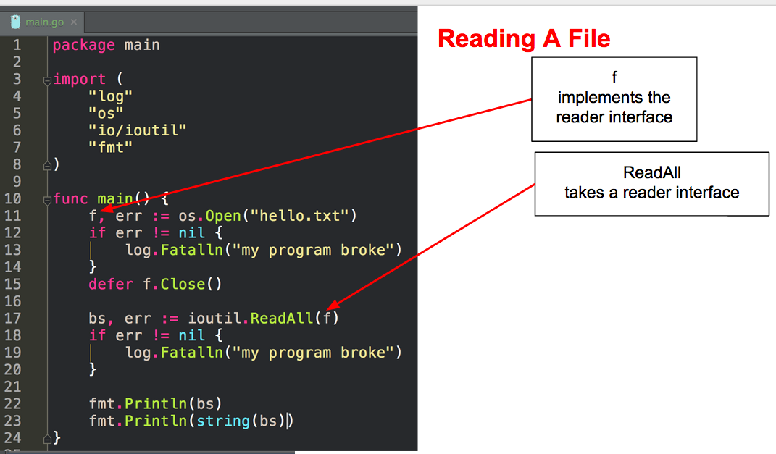
Different Functions
Different Functions
Functions that implement the io.Reader interface
Functions that take an io.Reader interface as an argument
common interface
io.Reader interface
any of the functions on the left
can be matched with any of the functions on the right
because all of the functions share a common, agreed upon way of interfacing with each other

Slide 28
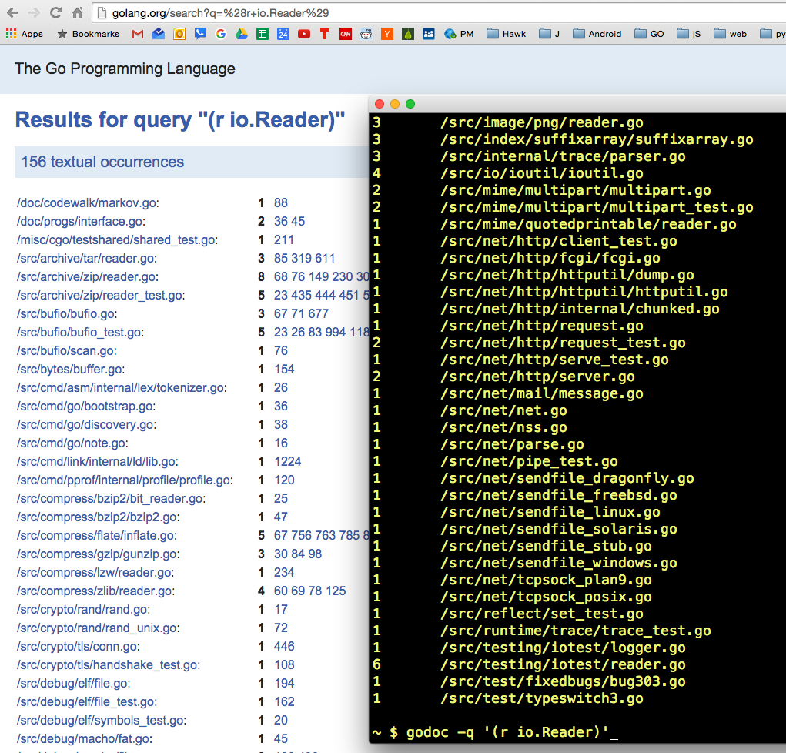
Who takes io.Reader
as an argument?

Slide 29
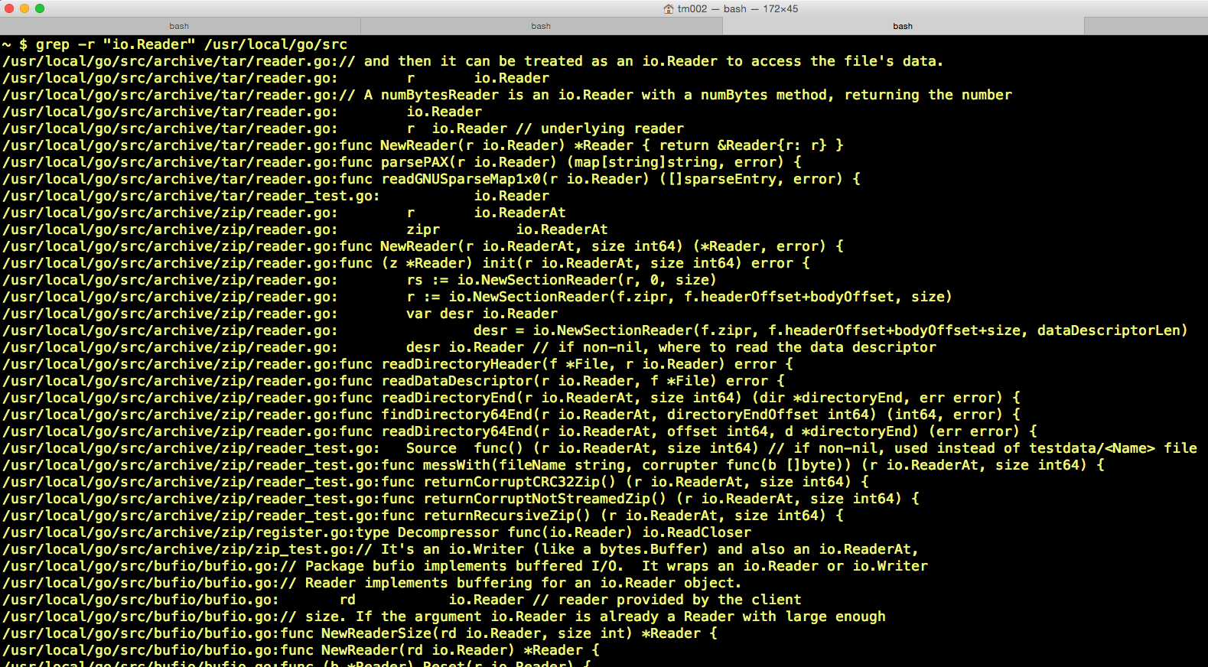
Who takes io.Reader
as an argument?

Slide 30
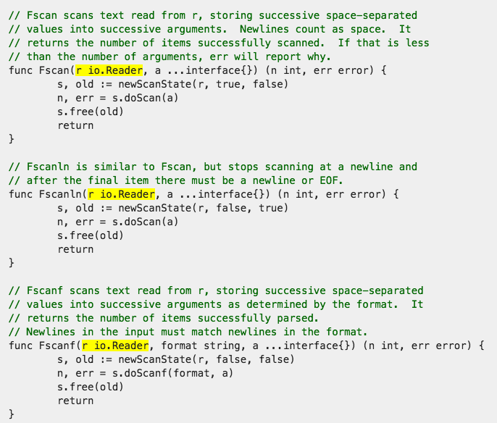
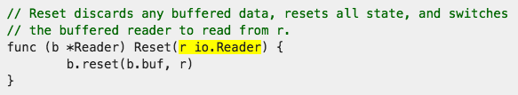
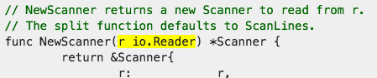
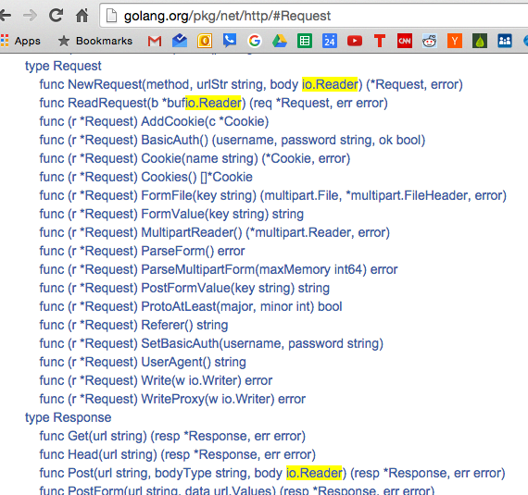
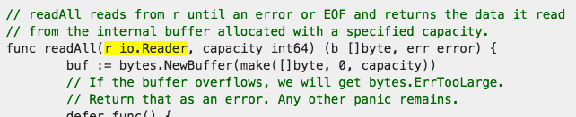
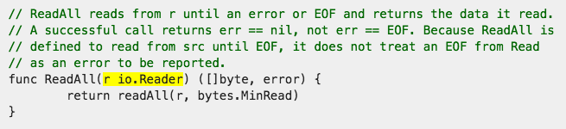
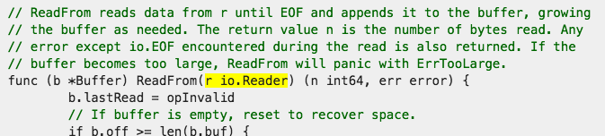
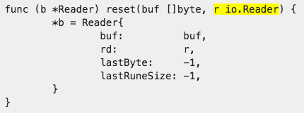
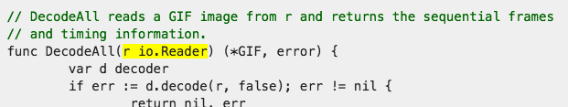
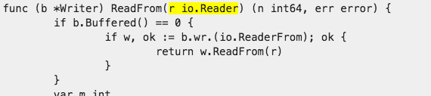
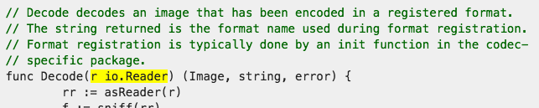

Slide 31




Eventually it all gets down to that read method being used

Slide 32
grep
globally search a regular expression and print)

Slide 33




Slide 34
strings.NewReader

Slide 35




This illustrates the flexibility of interfaces

Slide 36

methods

Slide 37


Readers
*os.File
Read
reads up to len(b) bytes from the File
func (f *File) Read(b []byte) (n int, err error)
Readdirnames
reads and returns a slice of names from the directory f
func (f *File) Readdirnames(n int) (names []string, err error)
io/ioutil
ReadAll
reads from r until an error or EOF and returns the data it read
func ReadAll(r io.Reader) ([]byte, error)
Readdir
reads the contents of the directory associated with file and returns a slice of up to n FileInfo values
func (f *File) Readdir(n int) (fi []FileInfo, err error)
Readdirnames
reads and returns a slice of names from the directory f.
func (f *File) Readdirnames(n int) (names []string, err error)

Slide 38

Readers
*strings.Reader
Read
reads up to len(b) bytes from the File
func (r *Reader) Read(b []byte) (n int, err error)
*bufio.Reader
Read
Read reads data into p
func (b *Reader) Read(p []byte) (n int, err error)
io
Copy
Copy copies from src to dst until either EOF is reached on src or an error occurs
func Copy(dst Writer, src Reader) (written int64, err error)
*csv.Reader
Read
Read reads one record from r. The record is a slice of strings with each string representing one field.
func (r *Reader) Read() (record []string, err error)

Slide 39


Just FYI
We create a NewReader
then pass it into ReadAll
ReadAll takes an Reader interface
a pointer to a strings.Reader implements io.Reader interface
NewReader returns a pointer to a strings.Reader

Slide 40
Writer Interface
io.writer

Slide 41


Slide 42


Slide 43


Slide 44


Slide 45



Slide 46
Does a *File implement the writer interface?

Slide 47
Does a *File implement the writer interface?
Yes.
We want to be able to read and write to a file

Slide 48
How we use the reader interface
*Reader implemented the reader interface
*File implemented the reader interface
What implements the
writer interface?

Slide 49


How we use the writer interface
*Reader implemented the reader interface
*File implements the
writer interface
What implements the
writer interface?

Slide 50

Are there any funcs in package ioutil
which a type could use if it is implementing the writer interface?

Slide 51
Are there any funcs in package ioutil
which a type could use if it is implementing the writer interface?
No.

Slide 52
Readers
*os.File
Write
Write writes len(b) bytes to the File.
func (f *File) Write(b []byte) (n int, err error)
io/ioutil
ReadAll
reads from r until an error or EOF and returns the data it read
func ReadAll(r io.Reader) ([]byte, error)
Readdir
reads the contents of the directory associated with file and returns a slice of up to n FileInfo values
func (f *File) Readdir(n int) (fi []FileInfo, err error)
Readdirnames
reads and returns a slice of names from the directory f.
func (f *File) Readdirnames(n int) (names []string, err error)

Slide 53
primitives

Slide 54
What are “I/O primitives”?

Slide 55
What are “I/O primitives”?
read
write

Slide 56

What are “I/O primitives”?
read
write

Slide 57

What are “I/O primitives”?
read
write

Slide 58
unix file permissions

Slide 59


unix file system permissions

